Slide 1
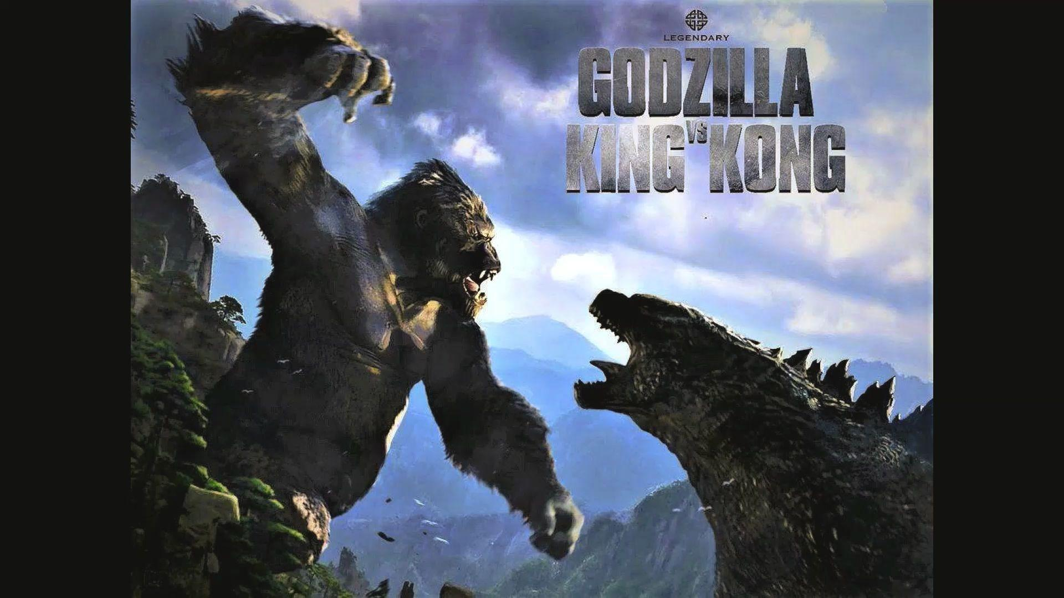
Godzilla vs Kong
Social Media Campaign Analysis
Presented by: Yijin Fu, Wei Lin
2021/4/12

Slide 2

Table of Contents
01
02
03
04
About the movie
Goals & Strategy
Market Analysis
Social Media Campaign
05
06
07
08
KPI
Market Performance
Forecasting Performance
Post-Motem Analysis

Slide 3
01.
About the movie

Slide 4
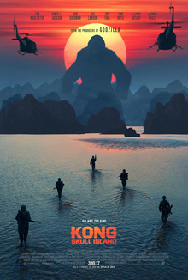
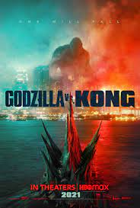
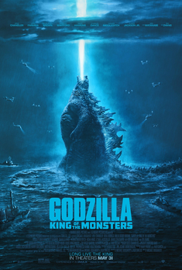


About Godzilla and King Kong
2017
Kong: Skull Island
11th film in King Kong franchise. Total $566 Million box profit worldwide, a huge success.
2021
Godzilla vs. Kong
A sequel to both Kong: Skull Island and Godzilla: King of the Monsters.
4th film in Monsterverse franchise.
Released in theatre and on HBO max simultaneously
2019
2014
Godzilla: King of the Monsters
35th film in Godzilla franchise. Total $386 Million box profit worldwide, a huge disappointment.
Legendary Entertainment was founded in Burbank, CA, in 2000. In 2014, Monsterverse Franchise started the monster films series feature in Godzilla and King Kong.

Slide 5
02.
Goals & Strategy

Slide 6
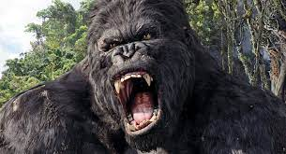
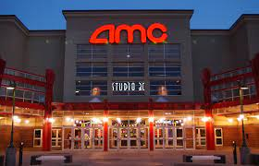
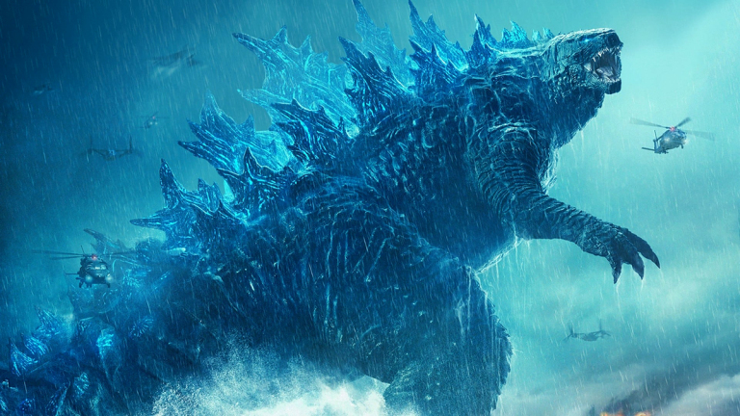
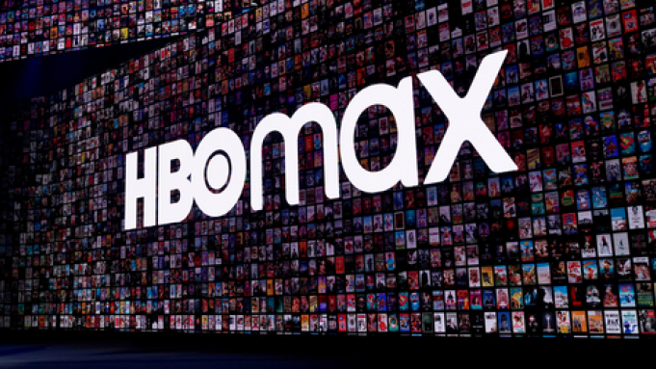
Goals
Short-term
Long-term
Recreate the Godzilla and King Kong IP
To create a shared cinematic universe between Godzilla and King Kong
Global box office success
Generate success and breakthrough in the HBO MAX online platform
Notes:
The short term goal of the movie is to recreate the Godzilla and King Kong IP, both IPs hasn’t been used since 2017 and 2019, and this was created to bring those IPs back to their fans and the audience. Another goal is to create a shared cinematic universe between Godzilla and King Kong. In terms of long-term goal, it is always the goal to pursue a successful global box office, and for this movie specifically, how to generate both success in thearte and on HBO max also becomes the consideration

Slide 7

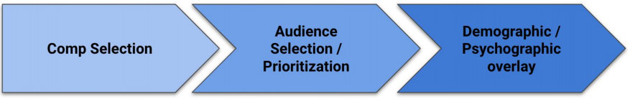
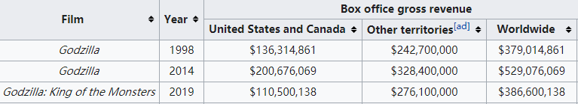
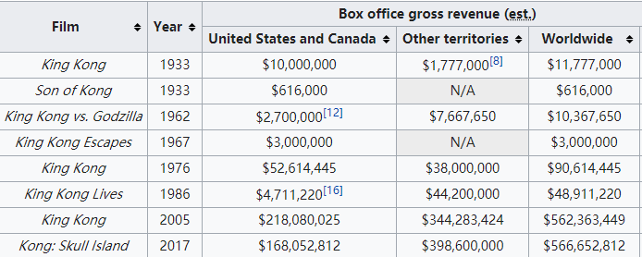
What movie to make?
Godzilla & King Kong Franchise
Trends & Outcome
Low ticket office and unsuccess in the most recent Godzilla IP VS. Successful King Kong performance.
Combined IP movie that would gather fans from two different IPs and corporate into a new film.
Notes:
Now looking at how the content of the movie was decided, which is also the first step in the Paramount’s approach. Considering back to the Godzilla and King Kong Franchise, the last movie of Godzilla was a disappointment as mentioned before, while the recent King Kong movie beat its original expectations. The director combined the two characters into one universe in order to attract attention from both sides of the fans, and the new monster universe could also generate its own series fans.

Slide 8
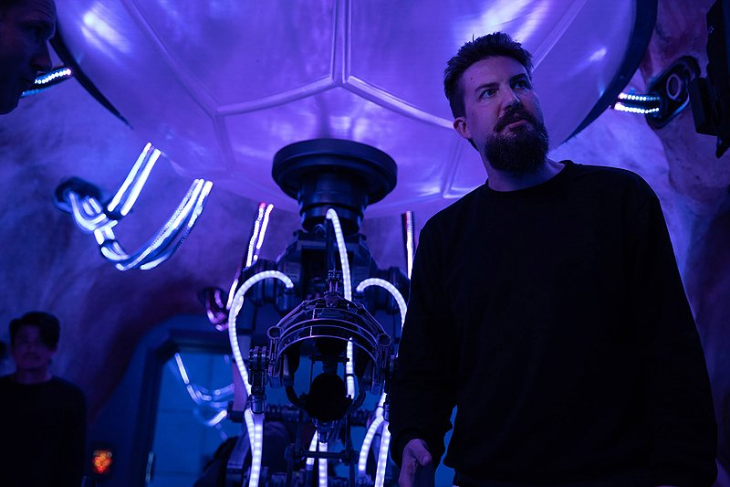
—Adam Wingard, director of Godzilla vs. Kong
“This is the Godzilla that we have here, this is legendary Godzilla, and let’s see how he matches up with King Kong. Let’s not try to change it up and do something different.”
Notes:
The purpose of this movie is not to create some whole new stories, but to use existing characters to generate new traffic and excitement. Just like what the director of Godzilla vs Kong Adam Wingard said:This is the Godzilla that we have here, this is legendary Godzilla, and let’s see how he matches up with King Kong. Let’s not try to change it up and do something different.

Slide 9

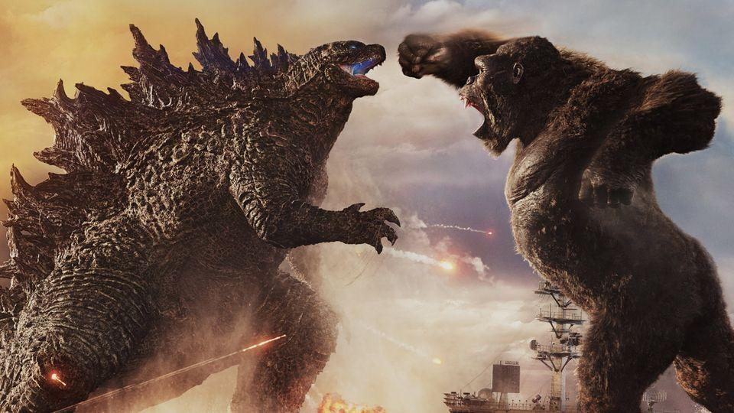
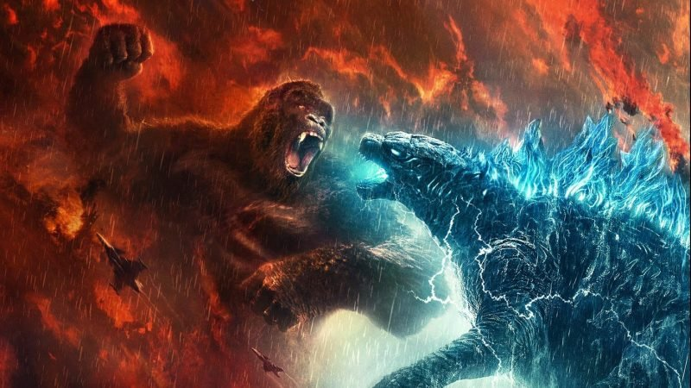
BUDGET : $330,000,000 US Dollars

Slide 10
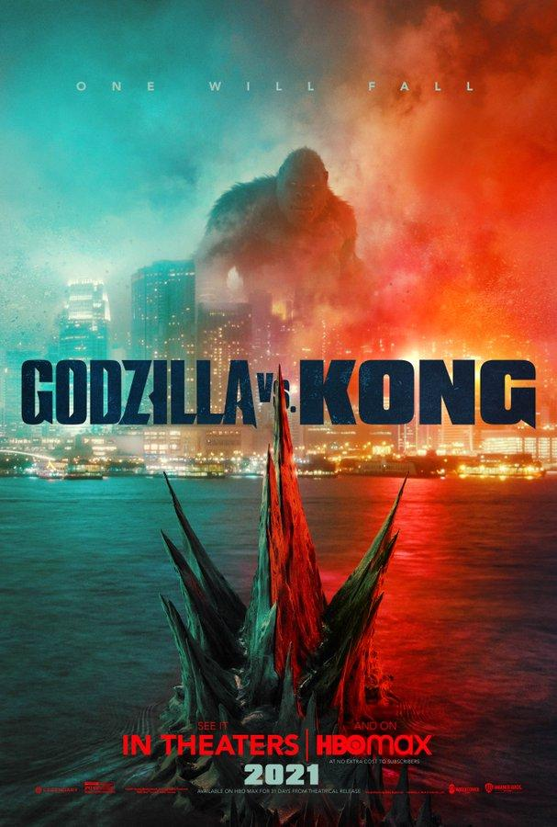
01
02
03
Marketing Strategy
04
05
06
Promotional Poster
(2019)
Develop a mobile game tie to the film release (2019)
Brief Clip (2019)
Trailer Released
(Jan 24th, 2021)
25.6 M views on YouTube in the first 24 hours
Graphic Novels
Toys released
(2020)
Preview on HBO Max
(2021)
Notes:
The budget was not only used for production of the movie, but also for marketing. Here is a timeline of the how Legendary entertainment promoted the movie. In 2019, it released its first promotional poster, as long as a mobile game tie to the release. In late 2019, the first brief clip was released on YouTube. In 2020, some graphic novels regarding godzilla and king kong was made online through official writers, and meanwhile the toys sets for both characters are released. Finally, at the beginning of 2021, preview of the movie was available on HBO max, followed by the official trailer released on Jan 24th,2021. The trailer had amost 26 million views on Youtube in the first 24 hours. From the huge traffic that the trailer generated, we can kind of predict that the box office for this movie will not be as disappointing as the previous Godzilla movie.

Slide 11
03.
Market Analysis

Slide 12
Audience Demographics
Age
16-24
Gender
25-32
Female
Over 50% from age 16-32 years
33-41
20%
42-55
+55
Male
80%

Slide 13
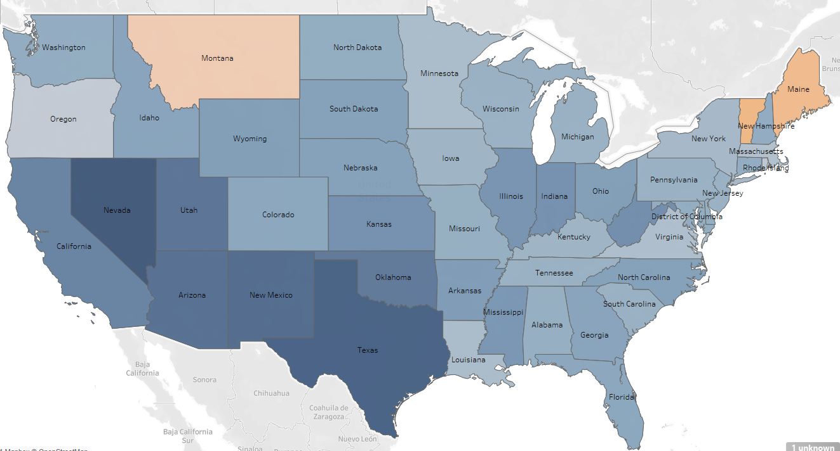
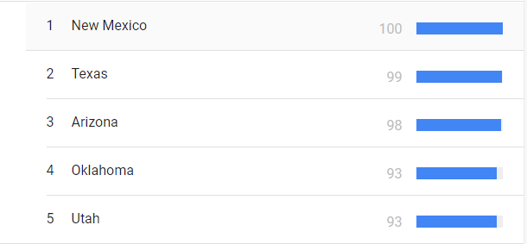
Interest Map Comparision ( Domestic)
Top 5 Interest Rank
Using Tableau
Sources from Google Trend

Slide 14
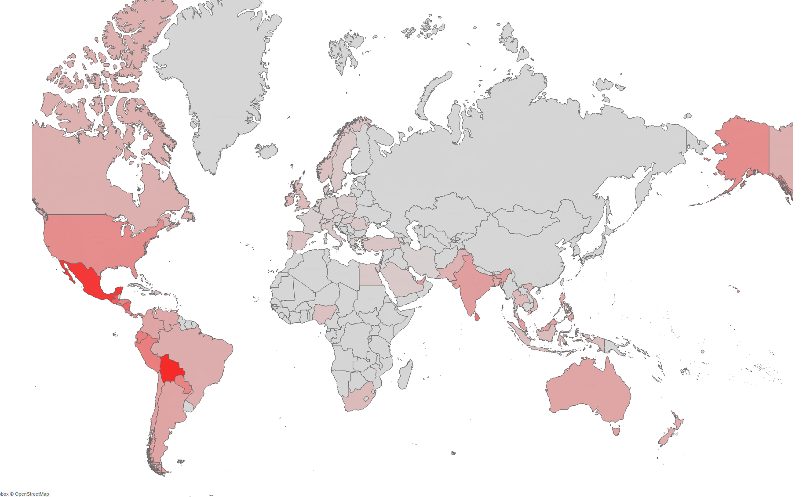
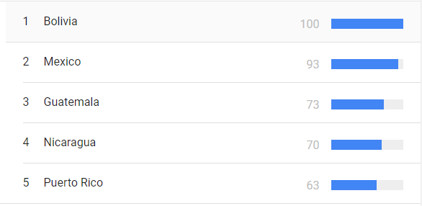
Interest Map Comparision ( International)
Top 5 Interest Rank
Using Tableau
Sources from Google Trend

Slide 15
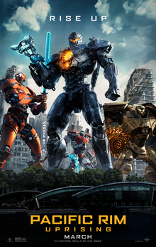

Similar Films Data
Love and Monsters
Pacific Rim Uprising
A 2018 American Science fiction action film directed by Steven S. DeKnight
A 2020 American monster adventure film directed by Michael Mattews

Slide 16
Analyzing the Competition
 | Pacific Rim Uprising | Love & Monster
Female
Male
Age <25
Age 25+
Despite being red, Mars is actually a cold place

Slide 17
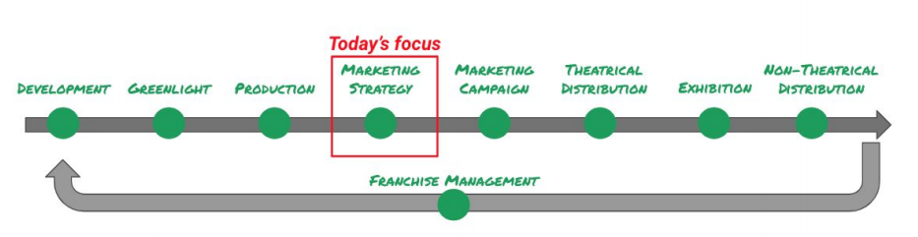
04.
Social Media Campaign
Notes:
Next, we are going to talk about social media campaign for Godzilla vs. Kong, This is the marketing strategy and marketing campaign part of the film lifecycle

Slide 18





Different platforms
Hashtags, create trending content
Fan Base
Find the community,
engage in discussions
2
3
4
5
Official releases Prepare for the next
Create Stories
Notes:
Multiple social media platforms has been used for the promotion of this movie, each playing a different role in the social media campaign. Twitter was used for generating trending moments, and it is famous for its hashtags. Of course this movie has generated multiple hashtags and we will talk more about it. YouTube is a platform used to release official content, like trailers and clips. Facebook as the the social media platform with most users, it is a place where most fans was based with the numerous amounts of fan pages. Instgram was used to create stories, could be stories during the film making process or any reactions from the fans. The official Godzilla and Kong instagram account constantly repost fan’s reactions to the movie. Lastly, Reddit is the platform where most of the discussions were located, and we will talk more about it too.

Slide 19
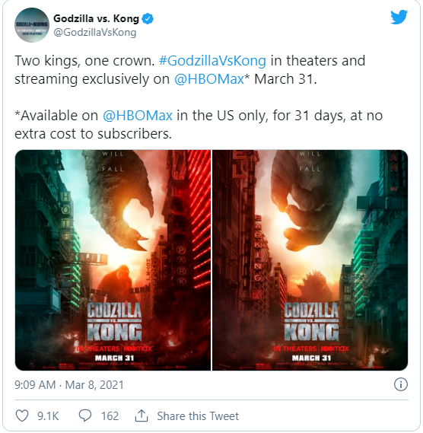
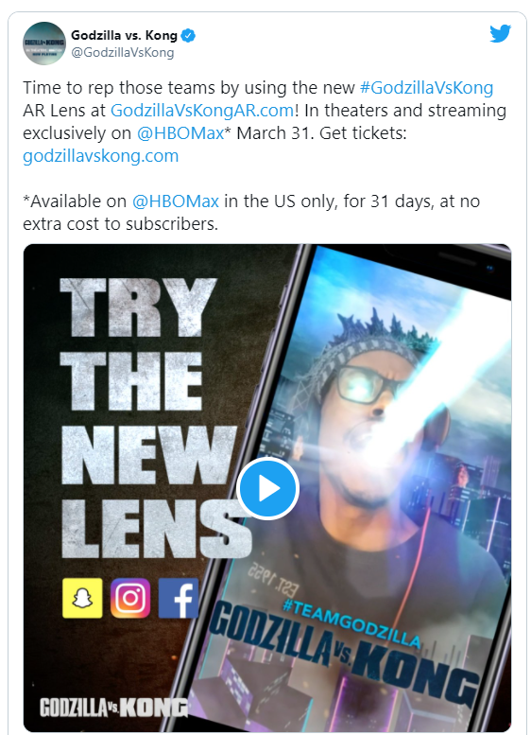
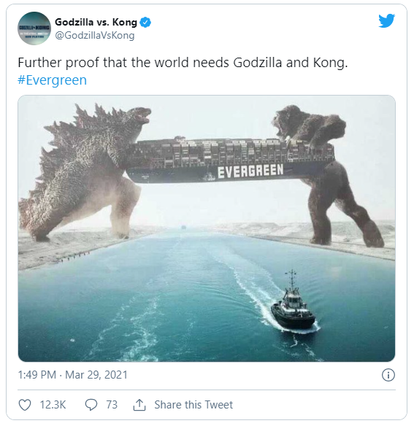
Twitter
Sponsored by “EVERGREEN”, a container transportation and shipping company.
Release information for HBOMax subscribers to watch Godzilla vs Kong for free for 31 days.
New AR Lens supporting the movie, following newest movie and technology trends
Notes:
First, we will take a closer look at the Twitter Campaign. The first post is about release the information about streaming the movie exclusively on HBO MAX to its subscribers free for 1 month, It is considered as a promotion post.. The second post was about promoting a new AR lens that is supporting the movie, it also brings the technology aspects to this movie. The last is a sponsor post, which the movie collaborated with “EVERGREEN”, a container transportation and shipping company, the post depicted godzilla and king kong holding the container together, which shows the theme of the movie but promoting the sponsor at the same time.

Slide 20
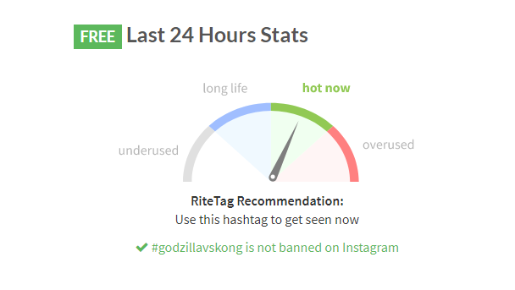
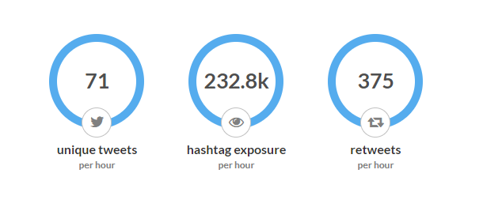
Twitter Cont. # godzillavskong
Engagement
Data was downloaded as of 2021/4/12, 0:17 a.m.
Hashtags of Godzilla vs Kong is trending on Twitter “HOT”
There are 71 unique tweets per hour, and with a 232.8k exposure.
Notes:
After learning about the twitter posts, our team used a twitter content search tool to study this particular hashtag, hashtag godzilla vs kong. The data was downloaded on early morning April 12th, this hashtag was rated “hot” on twitter, the result shows there are 71 unique tweets per hour that contains this certain hashtag, with an exposure of 232k per hour, which is an insane amount. It also shows that for those tweets including the hashtag godzilla vs kong, there are 375 retweets per hour, and it shows the engagement aspect of the social. All of these data shows that the movie is a huge success, and has generated some great crowd on social media.

Slide 21
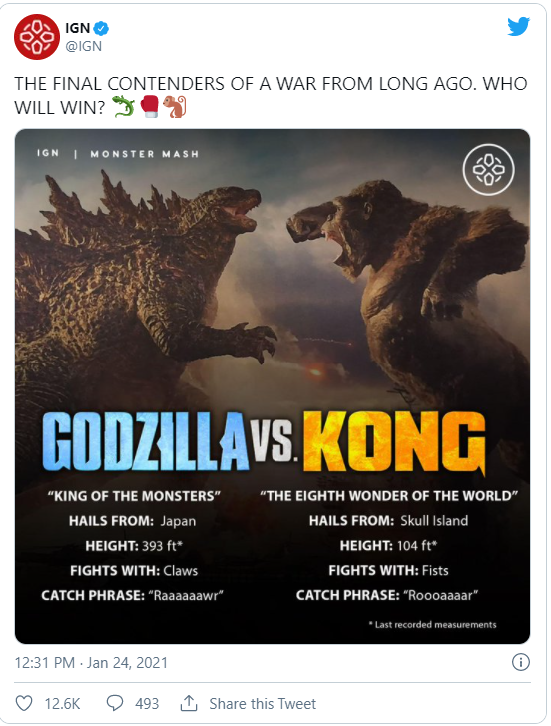
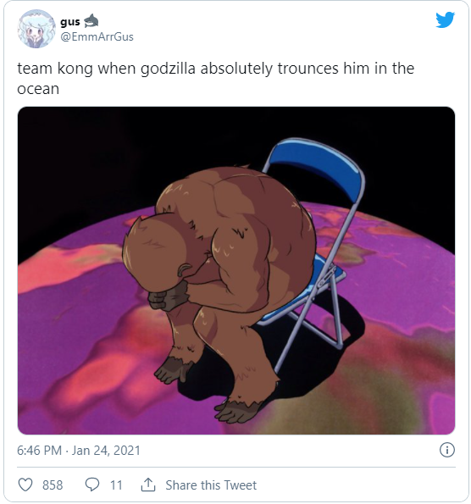
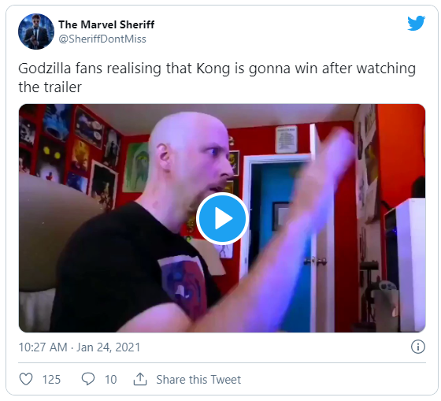
Fans pick side on Twitter
Movie Content causes fans to pick side for the two monsters
King Kong Fans
Godzilla Fans
Notes:
Another social media campaign that emerged online recently is that fans are picking sides on twitter supporting King Kong and Godziila. Since it is movie that involves two franchise, kinda of like Batman vs Superman, where each character has its fans and the fans are always rooting for their characters and don’t want it to be failed in the movie. As a result of this, multiple meme pictures are created on Twitter, and fans’ posts has created another wave of crowd on Twitter .

Slide 22

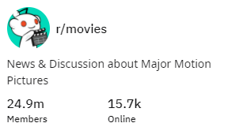
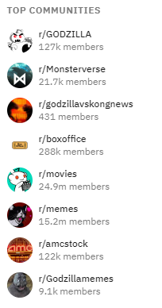
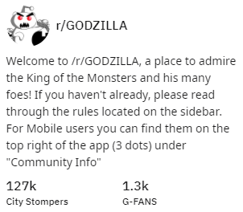
Other social media platforms
Reddit has generated more than 10,000 discussions on the movie under an official movie account in 1 post
Top communities in Reddit has over Millions of audience to discuss and chat about movie Godzilla vs. Kong
Notes:
Reddit on the other hand, is also a place where numerous fans and discussions were involved with. There are some official discussion about the movie from some official movie rating communities on Reddit. For this R movies community, the potential reach is 24.9 million people from all over the world, and this one discussion post has generated over 10k discussion. Of course there are many other communities with millions of audience available on Reddit too.

Slide 23
05.
KPI

Slide 24
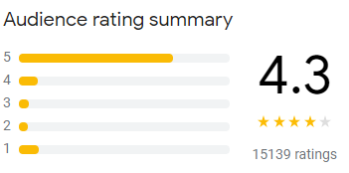
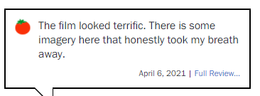
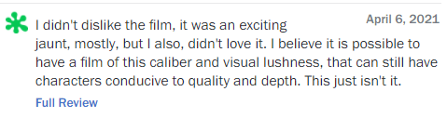
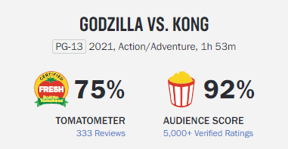
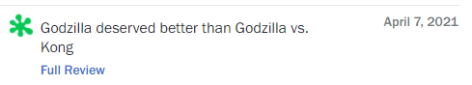
Sentiment
Positive
Negative
Netural
Notes:
First, talking about the sentiment, the overall rating for this movie on Google is 4.3, and also 92% audience score on Rotton tomatoes. Mostly, the movie showed positive sentiment, the word “terrifc” being used showing the positive sentiment, there are some negative sentiments, for example, “didn’t love it”, and some of the sentiment is neutral, with just some simple comments about the movie without too much emotion involved. Overall, the movie is successful, and positive sentiments weighted much more than negative and neutral.

Slide 25
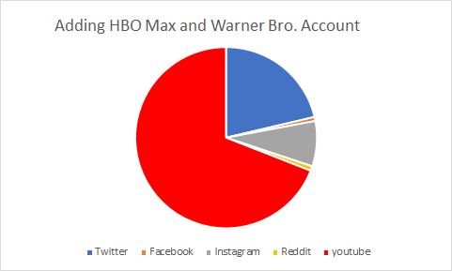
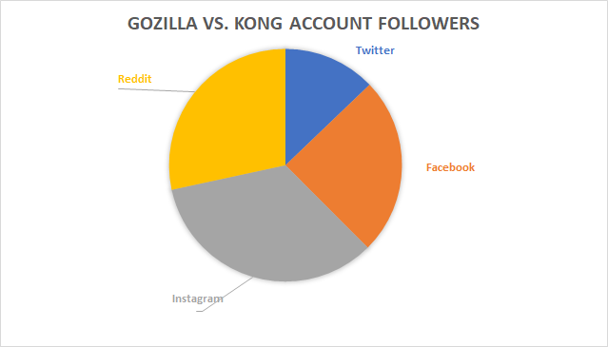
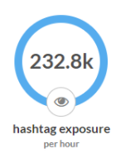
Reach & Exposure
More explosure
Twitter: 52k
Facebook: 100k
Instagram: 138k
Reddit: 115k
Twitter: 3.1 M
YouTube: 9.71 M
Twitter and YouTube has the most reach for Godzilla vs. Kong
Notes:
We also looked at the official account for this movie on different social media platforms to calculate the the potential reach and exposure from those account. When we only looking accounts for this particular movie, Instagram has 138k followers and is the most. But, by adding other official resources too, including official account for HBO Max, Warner Brother account, YouTube becomes the platform that has the most potential exposure. Recall earlier in the presentation that the trailer generated 25 million views in the first 24 hours, it is a reflection of how YouTube channel has the most exposure to the audience.

Slide 26
Engagement
 | Likes | Shares | Comments
Twitter | 10k | 2.1k | 1.6k
Instagram | 43k | - | 1.1k
YouTube | 2M | - | 262k
Likes, Shares and Comments for the official release of the movie
Notes:
Next, we are going to look into the engagement part of the social media, specifically, we are looking at the post from twitter, instagram and Youtube account when it first announced the release of the movie. The twitter post has 10k likes, 2.1 k shares, and 1.6 k comments, Instagram post has 4 times the likes compare to Twitter post. YouTube trailer has almost 2 M likes, and 262k comments, again, YouTube has show dominant power on engagement compared to other social media platforms. We would strongly suggest the movie to put more content on YouTube, and light the crowd again on social media.

Slide 27
06.
Market Performance

Slide 28

Overall box office
57%
46%
20%
43%
34%
$70,000,000
$288,600,000
$358,600,000
Domestic Box Office
International Box Office
Overall Box Office
CHINA
CHINA
U.S
Other

Slide 29
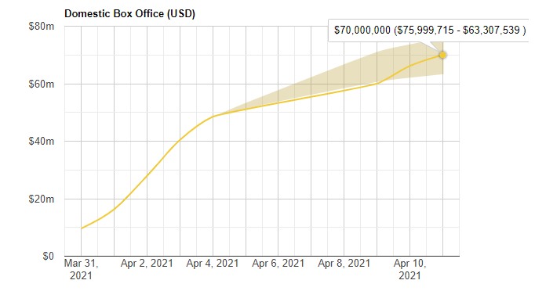
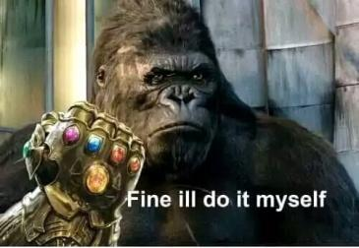
Domestic box office

Slide 30
Domestic box office
Date | Rank | Gross | % Change | Total Gross | Days
March 31 | 1 | 9,600,000 | / | 9,600,000 | 1
April 1 | 1 | 6,700,000 | -30% | 16,300,000 | 2
April 2 | 1 | 11,600,000 | 73% | 27,900,000 | 3
April 3 | 1 | 12,500,000 | 8% | 40,400,000 | 4
April 4 | 1 | 8,100,000 | -35% | 48,500,000 | 5
April 9 | 1 | 3,920,000 | -51% | 60,040,000 | 10
April 10 | 1 | 6,160,000 | 57% | 66,200,000 | 11
April 11 | 1 | 3,800,000 | -38% | 70,000,000 | 12

Slide 31
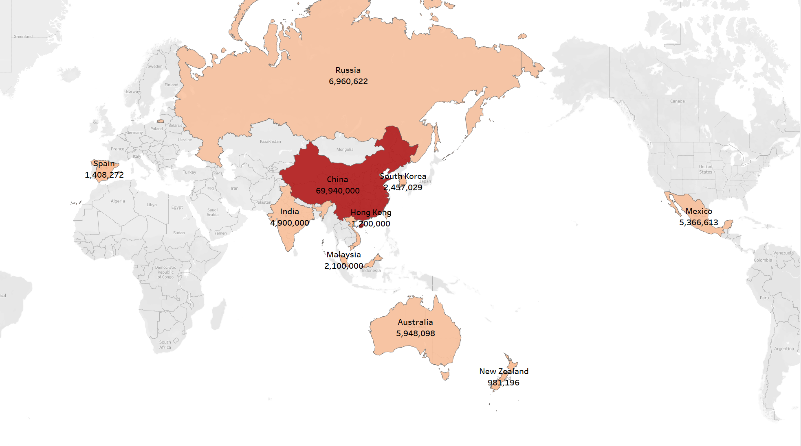
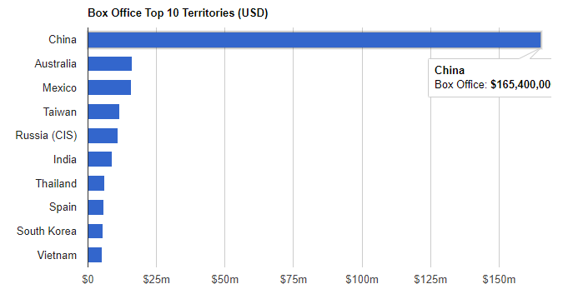

International box office
Opening weekend Box office

Slide 32
07.
Forcasting Performance

Slide 33
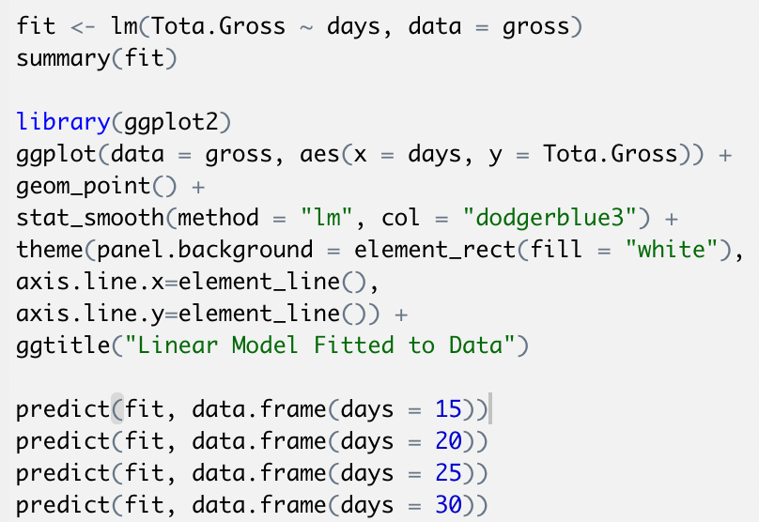
Domestic box office forecasting
Fit a linear regression by R
Check the residual and fitting degree
Make a prediction of the box office up to a month

Slide 34
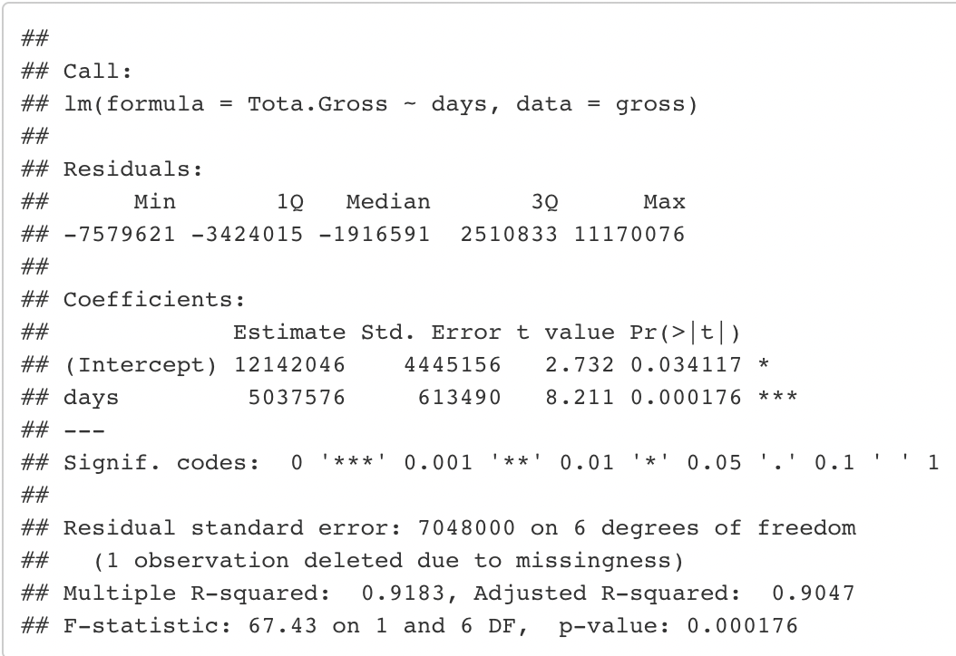
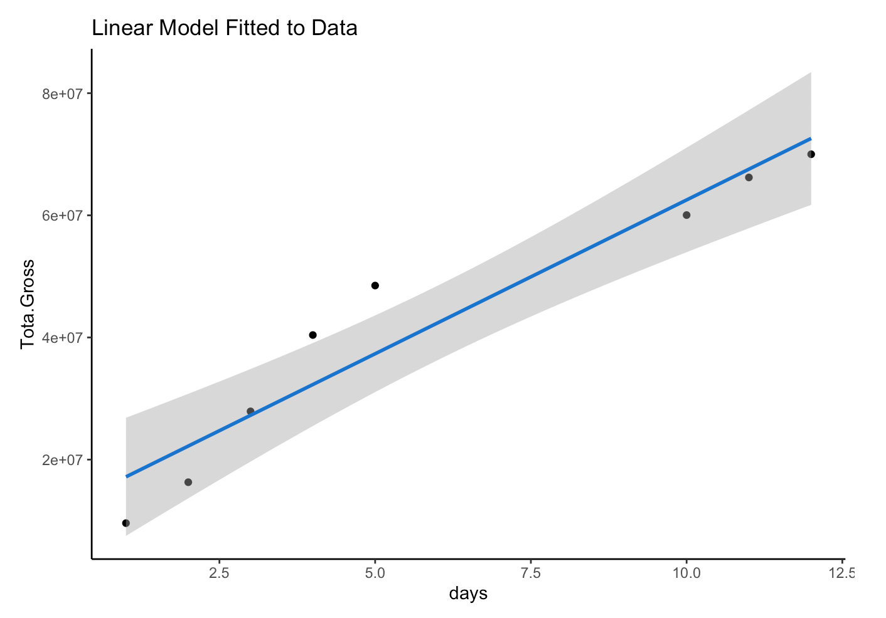
Domestic box office forecasting
Coefficient: 5,037,576
P-value: 0.000176
R-square: 0,9183
Almost all points resides in 95% confidence interval

Slide 35
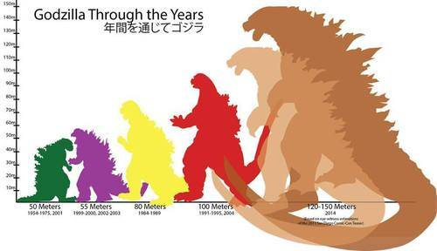
Domestic box office forecasting
FEED?
Total Gross Through the Days
Total Gross | Days
87,705,682 | 15
112,893,561 | 20
138,081,439 | 25
163,269,318 | 30

Slide 36
08.
Post-Mortem Analysis

Slide 37
Recap of Paramount’s Approach
4th
50%
72
Monsterverse Franchise Movies
Age 16-32 Audience
Average Trending Score
Top interest states include Nevada, Texas, New Mexico, Hawaii, Arizona, Utah and California.
Recreated the Godzilla and King Kong IP
Bring two legendary characters into one movie
According to exit polling of Godzilla and King Kong previous movies on Reddit
Should target audience age from 16-32

Slide 38
Recap of Social Media Campaign
Pros
Cons
Multiple platforms
Successful Twitter campaign
Exposure was GREAT
Partnerships
Scattered strategies
Not enough reach
Lack of official events
More content on YouTube

Slide 39
Recap of The Forecast/Challenges
8
55%
Days of data available
US Theater Capacity
Forecasting is based on the current data, with only 12 days available, so the variance is huge within the model
The pandemic kept the US Theater at a 55% capacity level at this time, so the box office number has the potential to explode after widely distribution of the vaccine.
limited amount of resources available
A bigger sample size would create a more accurate forecast

Slide 40

Thanks

Slide 41
Resources
https://www.the-numbers.com/movie/Godzilla-vs-Kong-(2020)#tab=box-office
https://www.boxofficemojo.com/releasegroup/gr3306770949/
https://www.boxofficepro.com/weekend-box-office-godzilla-vs-kong-voyagers/
https://ritetag.com/hashtag-stats/godzillavskong
https://en.wikipedia.org/wiki/Godzilla_vs._Kong#Marketing
https://en.wikipedia.org/wiki/Godzilla_(franchise)
https://en.wikipedia.org/wiki/King_Kong_(franchise)
https://www.reddit.com/r/GODZILLA/comments/bnpll3/godzilla_fan_demographics_survey_results_followup/
https://deadline.com/2021/04/godzilla-vs-kong-hbo-max-viewers-weekend-box-office-1234727926/
https://trends.google.com/trends/explore?q=%2Fg%2F11fd7dbn8v&geo=US
https://www.the-numbers.com/movie/Love-and-Monsters-(2020)#tab=summary
https://www.the-numbers.com/movie/Pacific-Rim-Uprising#tab=summary
https://cinematicslant.com/2021/03/31/godzilla-vs-kong-marketing-recap/
https://www.sportskeeda.com/esports/godzilla-vs-kong-memes-trend-online-fans-pick-sides
https://www.rottentomatoes.com/m/godzilla_vs_kong
Godzillavskong Twitter Account
GodzillavsKong Instagram Account

